Slide 1

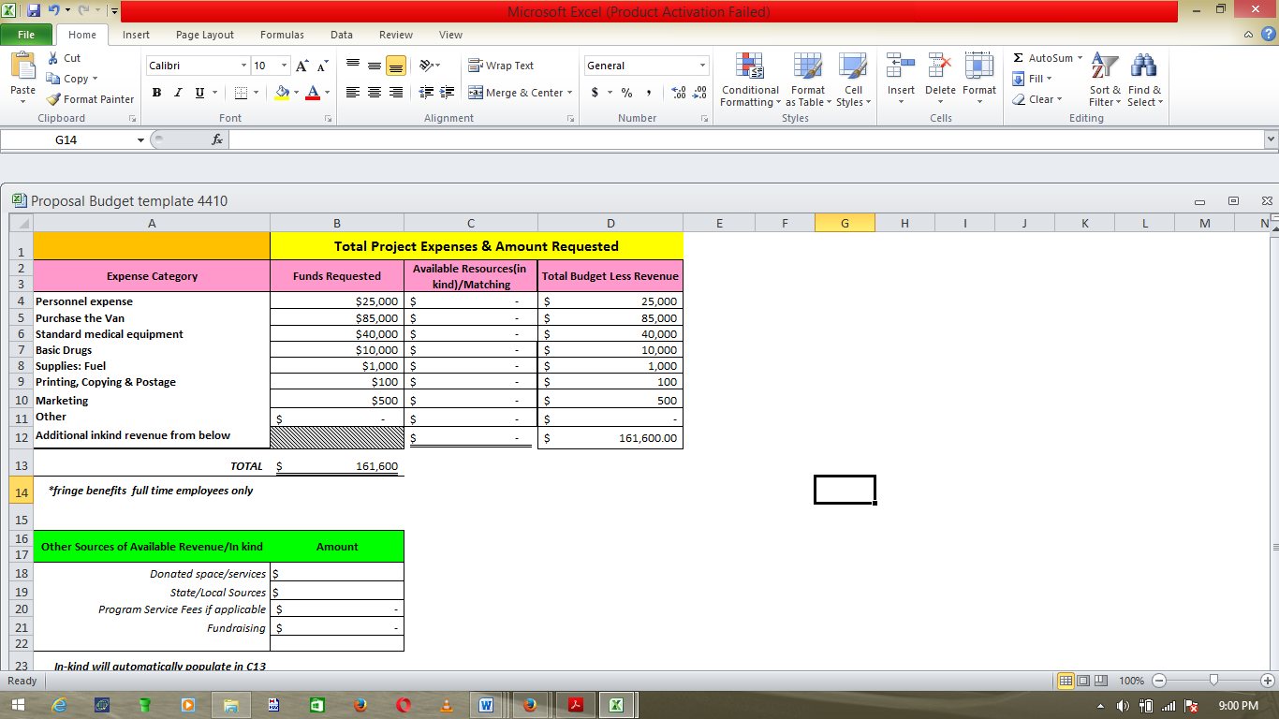
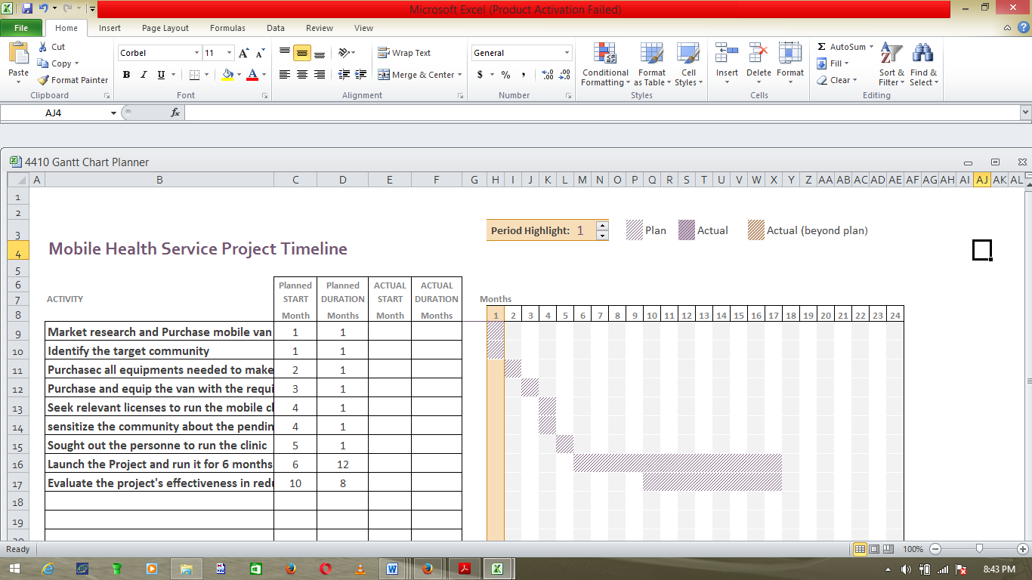
Proposal for Free Mobile Health Service
￼
ABSTRACT
TITLE:
Proposal for Free Mobile Health Service
BACKGROUND:
There are so many people living in the rural areas who are not in the position to access healthcare services due to the socio-economic disadvantages that afflicts these populations living in the rural areas and below poverty line.
OBJECTIVE:
To offer free primary health care to the target population
To offer ease of access to a healthcare services
To institute Public Health preventive measures that are specific and tailored to the needs of the target community
METHODS:
Launching a one year free Mobile Clinic in the target community to offer primary healthcare services and institute appropriate public health preventive measures in the target community.
RESULTS:
The project’s effectiveness in reducing the burden of infectious diseases will be assessed using two surveys that will be 4 months apart to compare the burden of the disease before and after the institution of the program.
BUDGET
TIMEFRAME
CAPSTONE EXPERIENCE
Learning Experience:
Very informative and highly enjoyable
Highly practical
Relevant as it builds on leadership skills that can be employed in whatever setup
Learning Outcomes experienced:
CONCLUSION
Project: Free Mobile Health Service
Targeting communities living below the poverty lines with significant burden of infectious diseases
Main Objective:
To increase access to healthcare services in a bid to reduce burden of disease in the community
Learning Experience:
Very informative
Highly practical
Relevant as it builds on leadership skills that can be employed in whatever setup
Learning Outcomes experienced:
For additional information please contact:
[Name]
[Department]
[Institution or organization]
[E-mail address]

